Slide 1

Injective and Bounded Distortion mappings in 3D
Noam Aigerman & Yaron Lipman
Weizmann Institute of Science

Slide 2
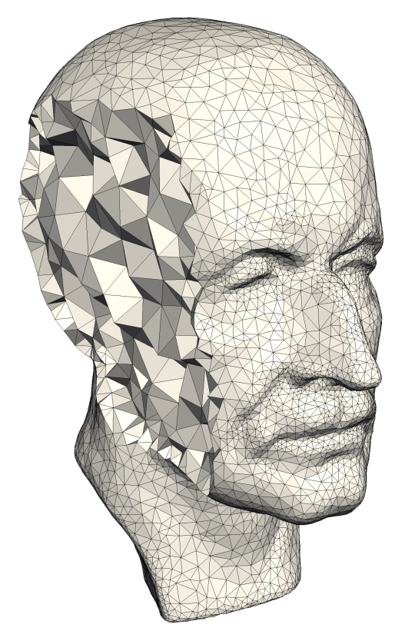
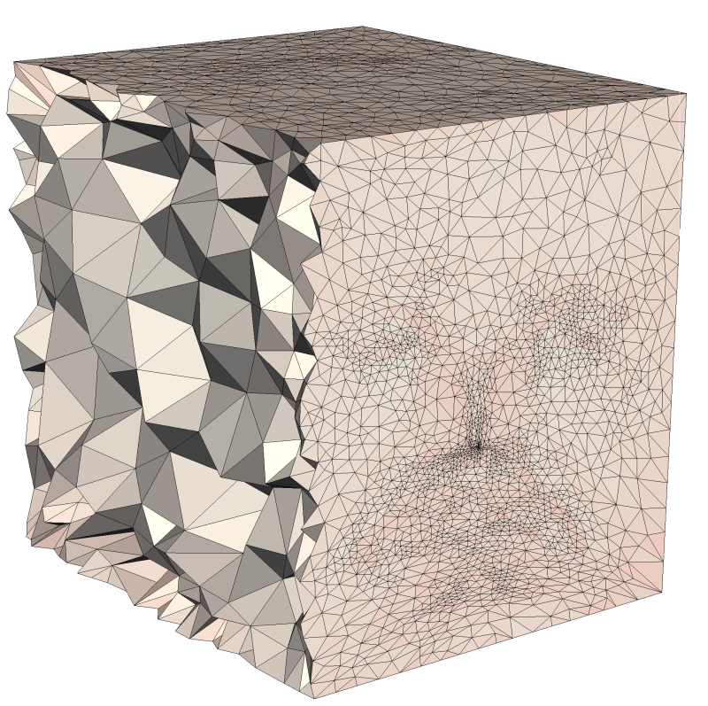
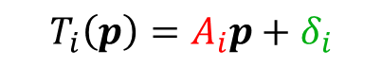
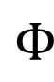
Mappings of tetrahedral meshes
$$T_{i}\left(p\right)=A_{i}p+δ_{i}$$
$$Φ$$

Slide 3
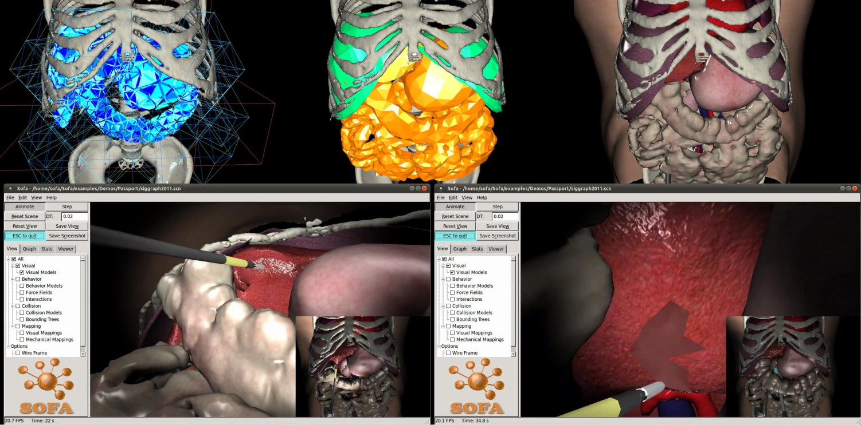
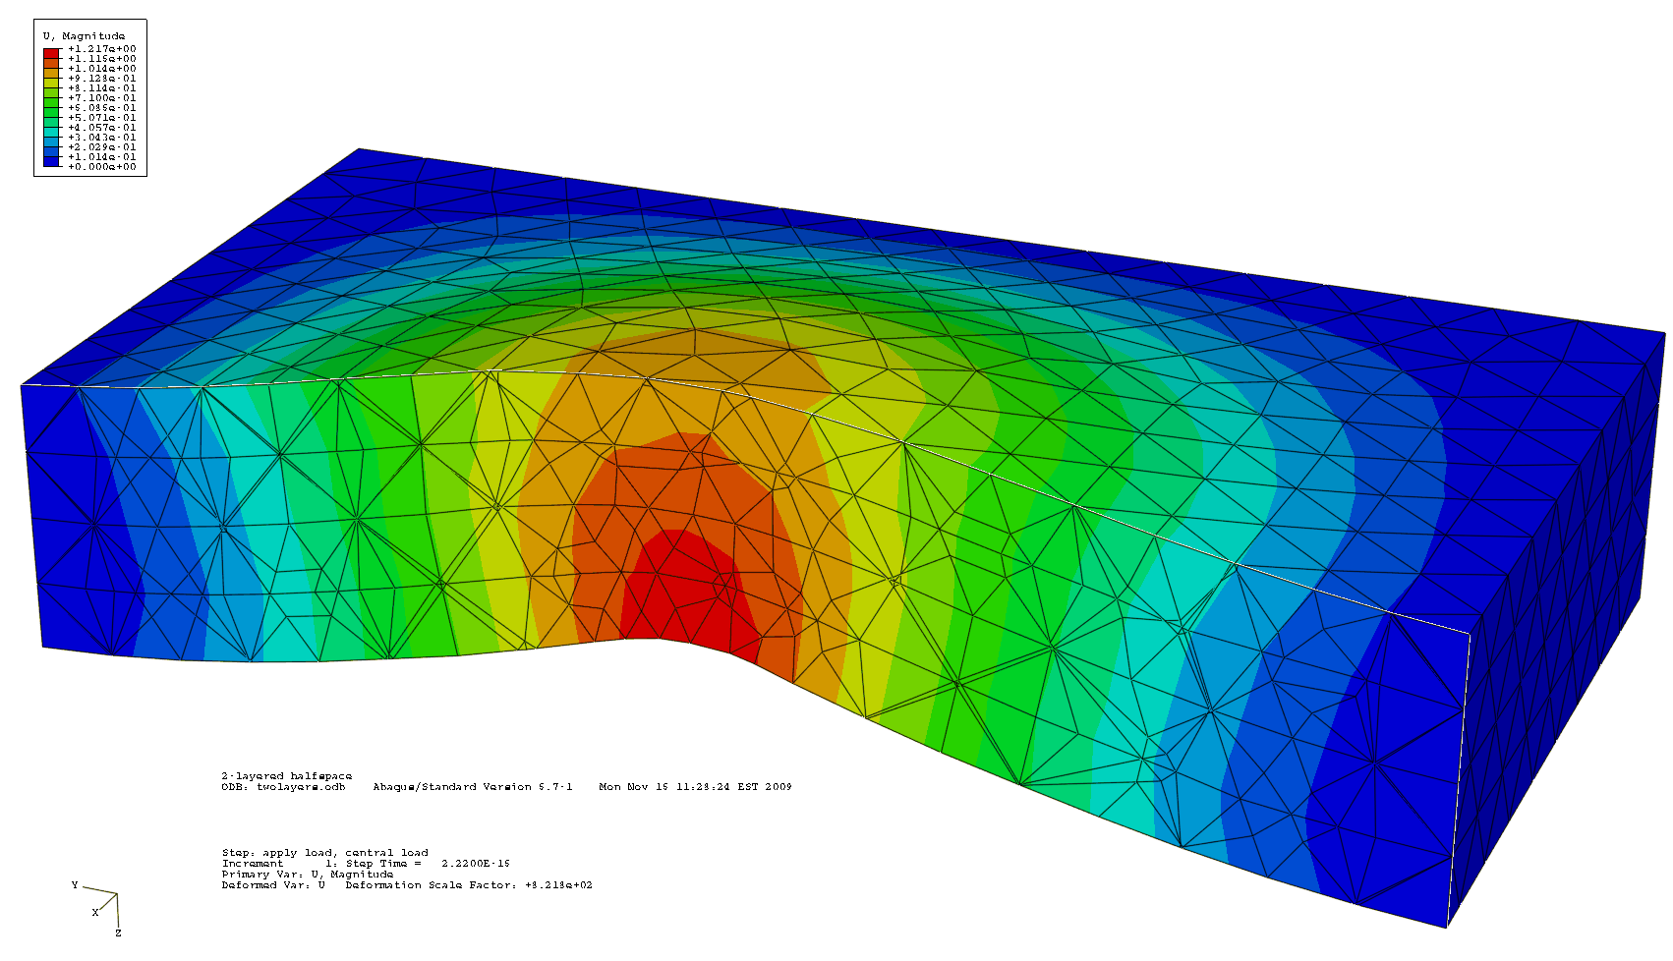
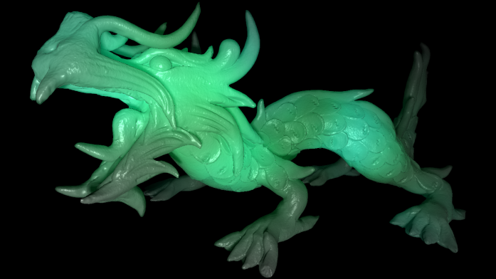
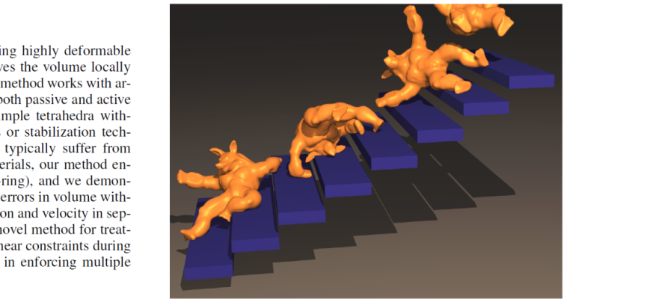
Applications
Medical training
Engineering
[Inria 2011]
Rendering
Physical Simulation
[Irving 2007]

Slide 4
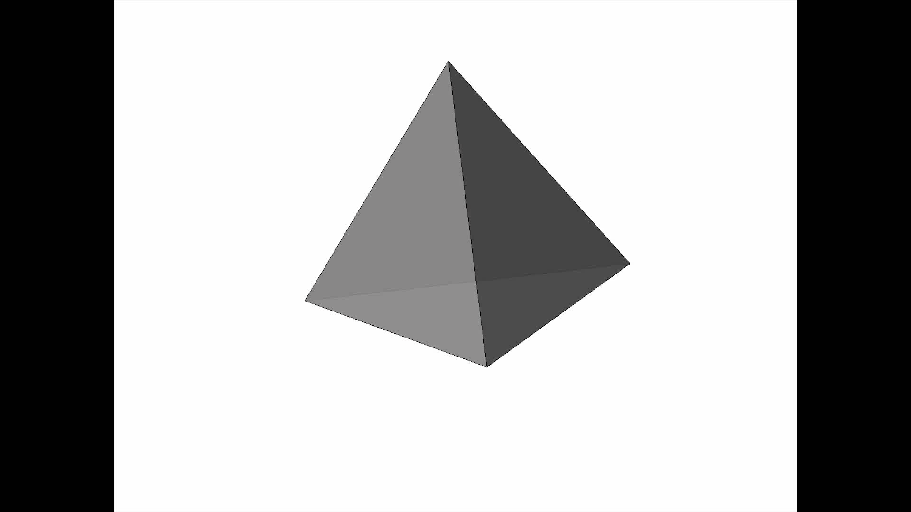
Two key properties of mappings
Aspect-ratio distortion
Bijectivity

Slide 5
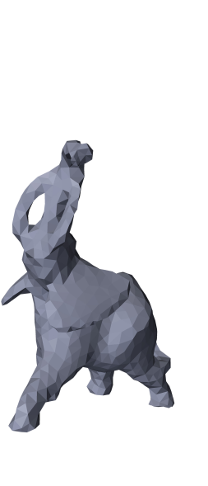
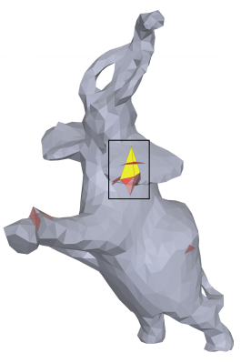
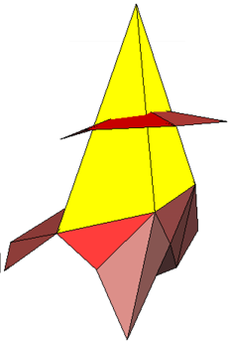

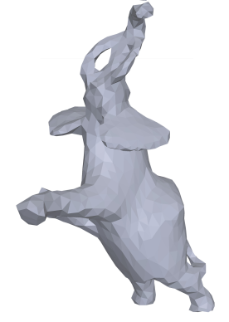
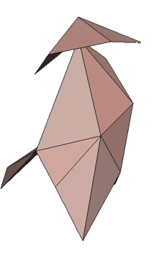
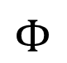
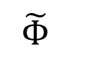

Goal
Input: Mapping $Φ$
High Distortion
$$Φ$$
Output: Bijective Bounded-Distortion $\tilde{Φ}≈Φ$
Low
Distortion
$$\tilde{Φ}$$
Inversion

Slide 6
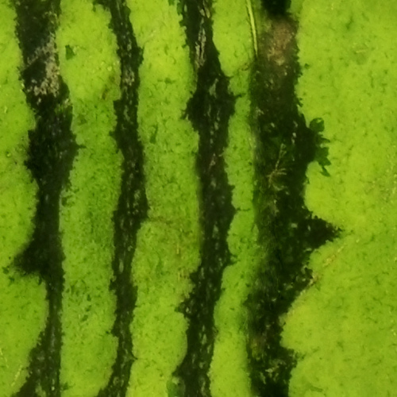
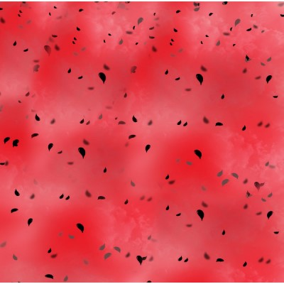

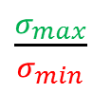



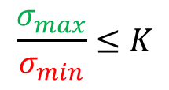
BD Linear transformation
$$A$$
$${ M}_{K}$$
Bounded Distortion
Distortion
Inversion
$\frac{σ_{max}}{σ_{min}}$
$$\det\left(A\right)<0$$
$$\frac{σ_{max}}{σ_{min}}≤K$$
$$\det\left(A\right)>0$$

Slide 7

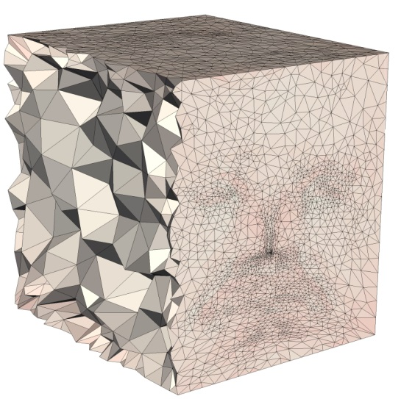
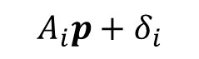


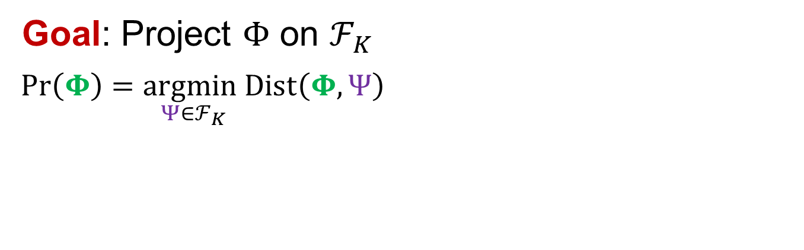

Problem formulation
$${ M}_{K}$$
Goal: Project $Φ$ on $ℱ_{K}$
$Pr\left(Φ\right)=\underset{Ψ∈ℱ_{K}}{argmin}Dist\left(Φ,Ψ\right)⁡$
$$A_{i}p+δ_{i}$$
$${ ℱ}_{K}$$
$$Φ$$

Slide 8
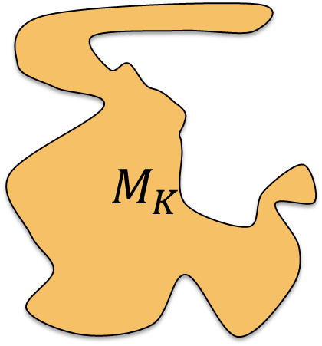
Main difficulty: BD is hard
Non-Convex, High dimension
Singular Values, roots of high-order polynomials
2D techniques do not extend to 3D
$M_{K}$

Slide 9
Our approach

Slide 10
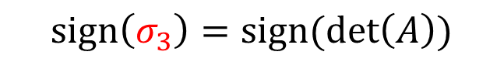

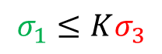

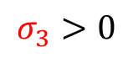

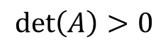
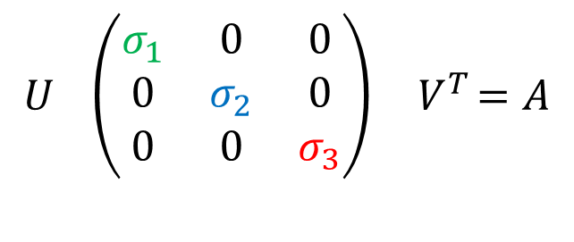
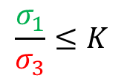
Signed SVD
“Classic” SVD
Signed SVD
$$U \left(\begin{matrix}σ_{1} & 0 & 0 \\ 0 & σ_{2} & 0 \\ 0 & 0 & σ_{3}\end{matrix}\right){ V}^{T}=A$$
Bounded Distortion
$$\det\left(A\right)>0$$
$$σ_{3}>0$$
Rotation
Unitary
Unitary
Rotation
$$\frac{σ_{1}}{σ_{3}}≤K$$
$$σ_{1}≤Kσ_{3}$$
$$σ_{1}≥σ_{2}≥σ_{3}≥0$$
$$|$$
$$|$$
$$sign\left(σ_{3}\right)=sign(\det\left(A\right))$$

Slide 11
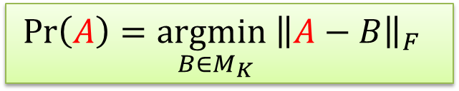

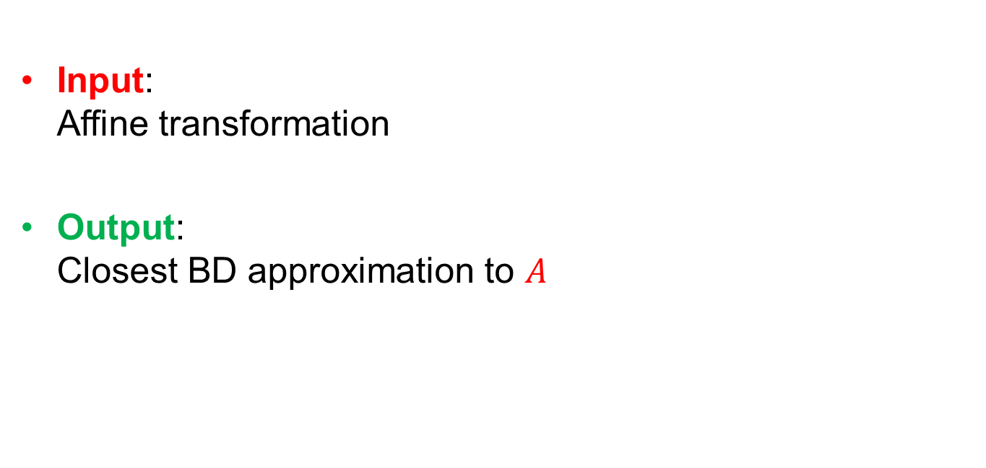
Solution for single tet
Input: Affine transformation
Output: Closest BD approximation to $A$
$$Ap+δ$$
Has closed-form solution!
$$Pr\left(A\right)=\underset{B∈M_{K}}{argmin}{\left\|A−B\right\|}_{F}⁡⁡$$

Slide 12
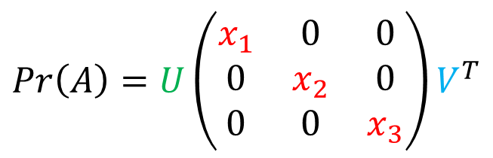
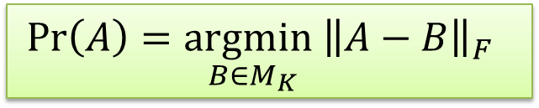
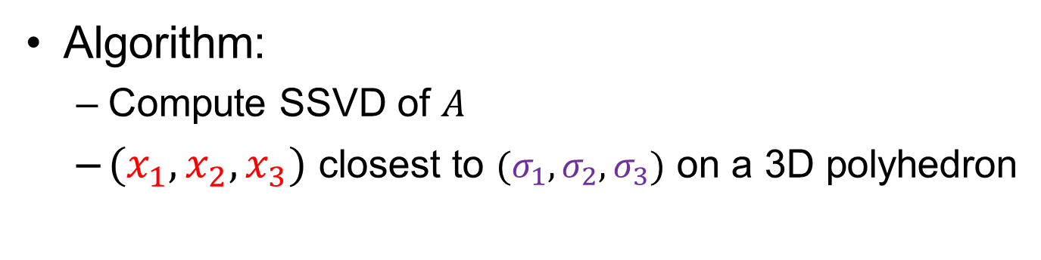
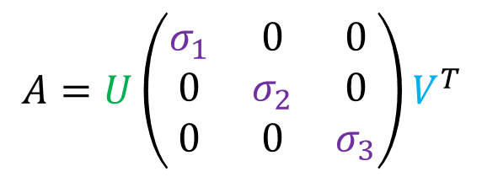
Solution for single tet
$$Pr\left(A\right)=\underset{B∈M_{K}}{argmin}{\left\|A−B\right\|}_{F}⁡⁡$$
$A=U\left(\begin{matrix}σ_{1} & 0 & 0 \\ 0 & σ_{2} & 0 \\ 0 & 0 & σ_{3}\end{matrix}\right)V^{T}$
$$\operatorname{Pr}\left(A\right)=U\left(\begin{matrix}x_{1} & 0 & 0 \\ 0 & x_{2} & 0 \\ 0 & 0 & x_{3}\end{matrix}\right)V^{T}$$
Algorithm:
Compute SSVD of $A$
$(x_{1},x_{2},x_{3})$ closest to $(σ_{1},σ_{2},σ_{3})$ on a 3D polyhedron

Slide 13
Solution for one tet is not enough
Why not project each tet separately?

Slide 14
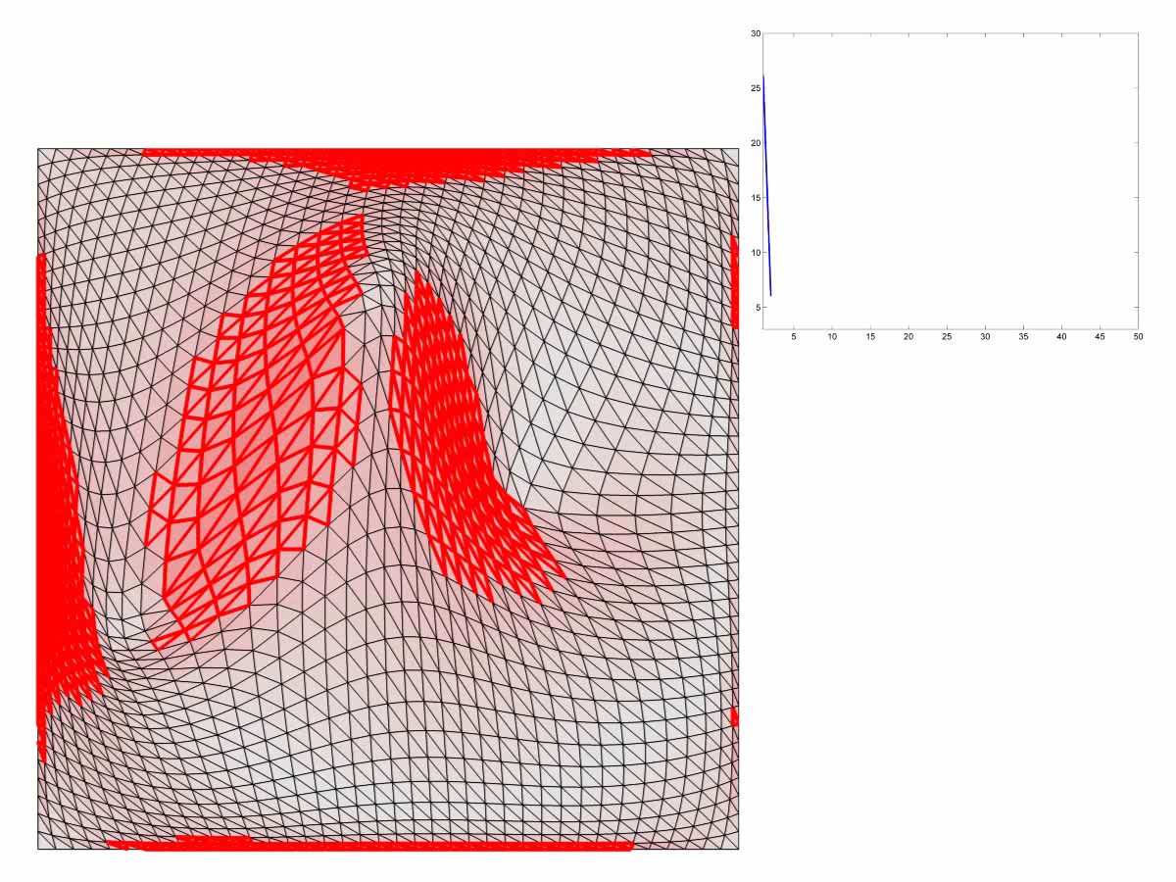
Naïve approach
Find closest continuous map (Solve Poisson)

Slide 15
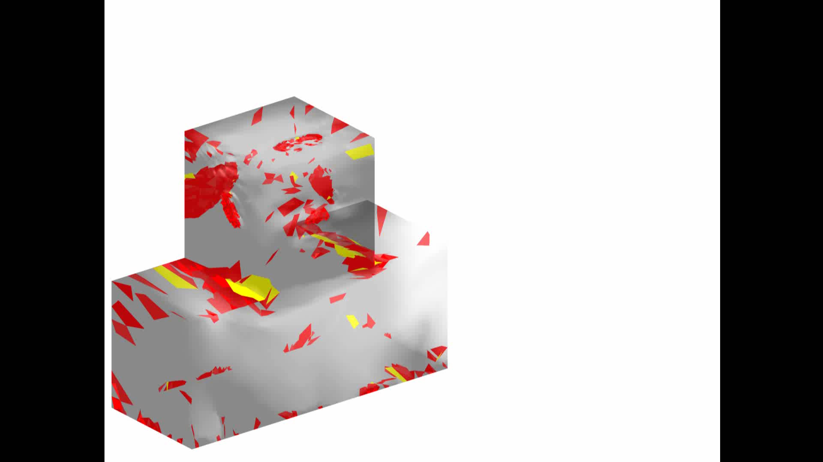
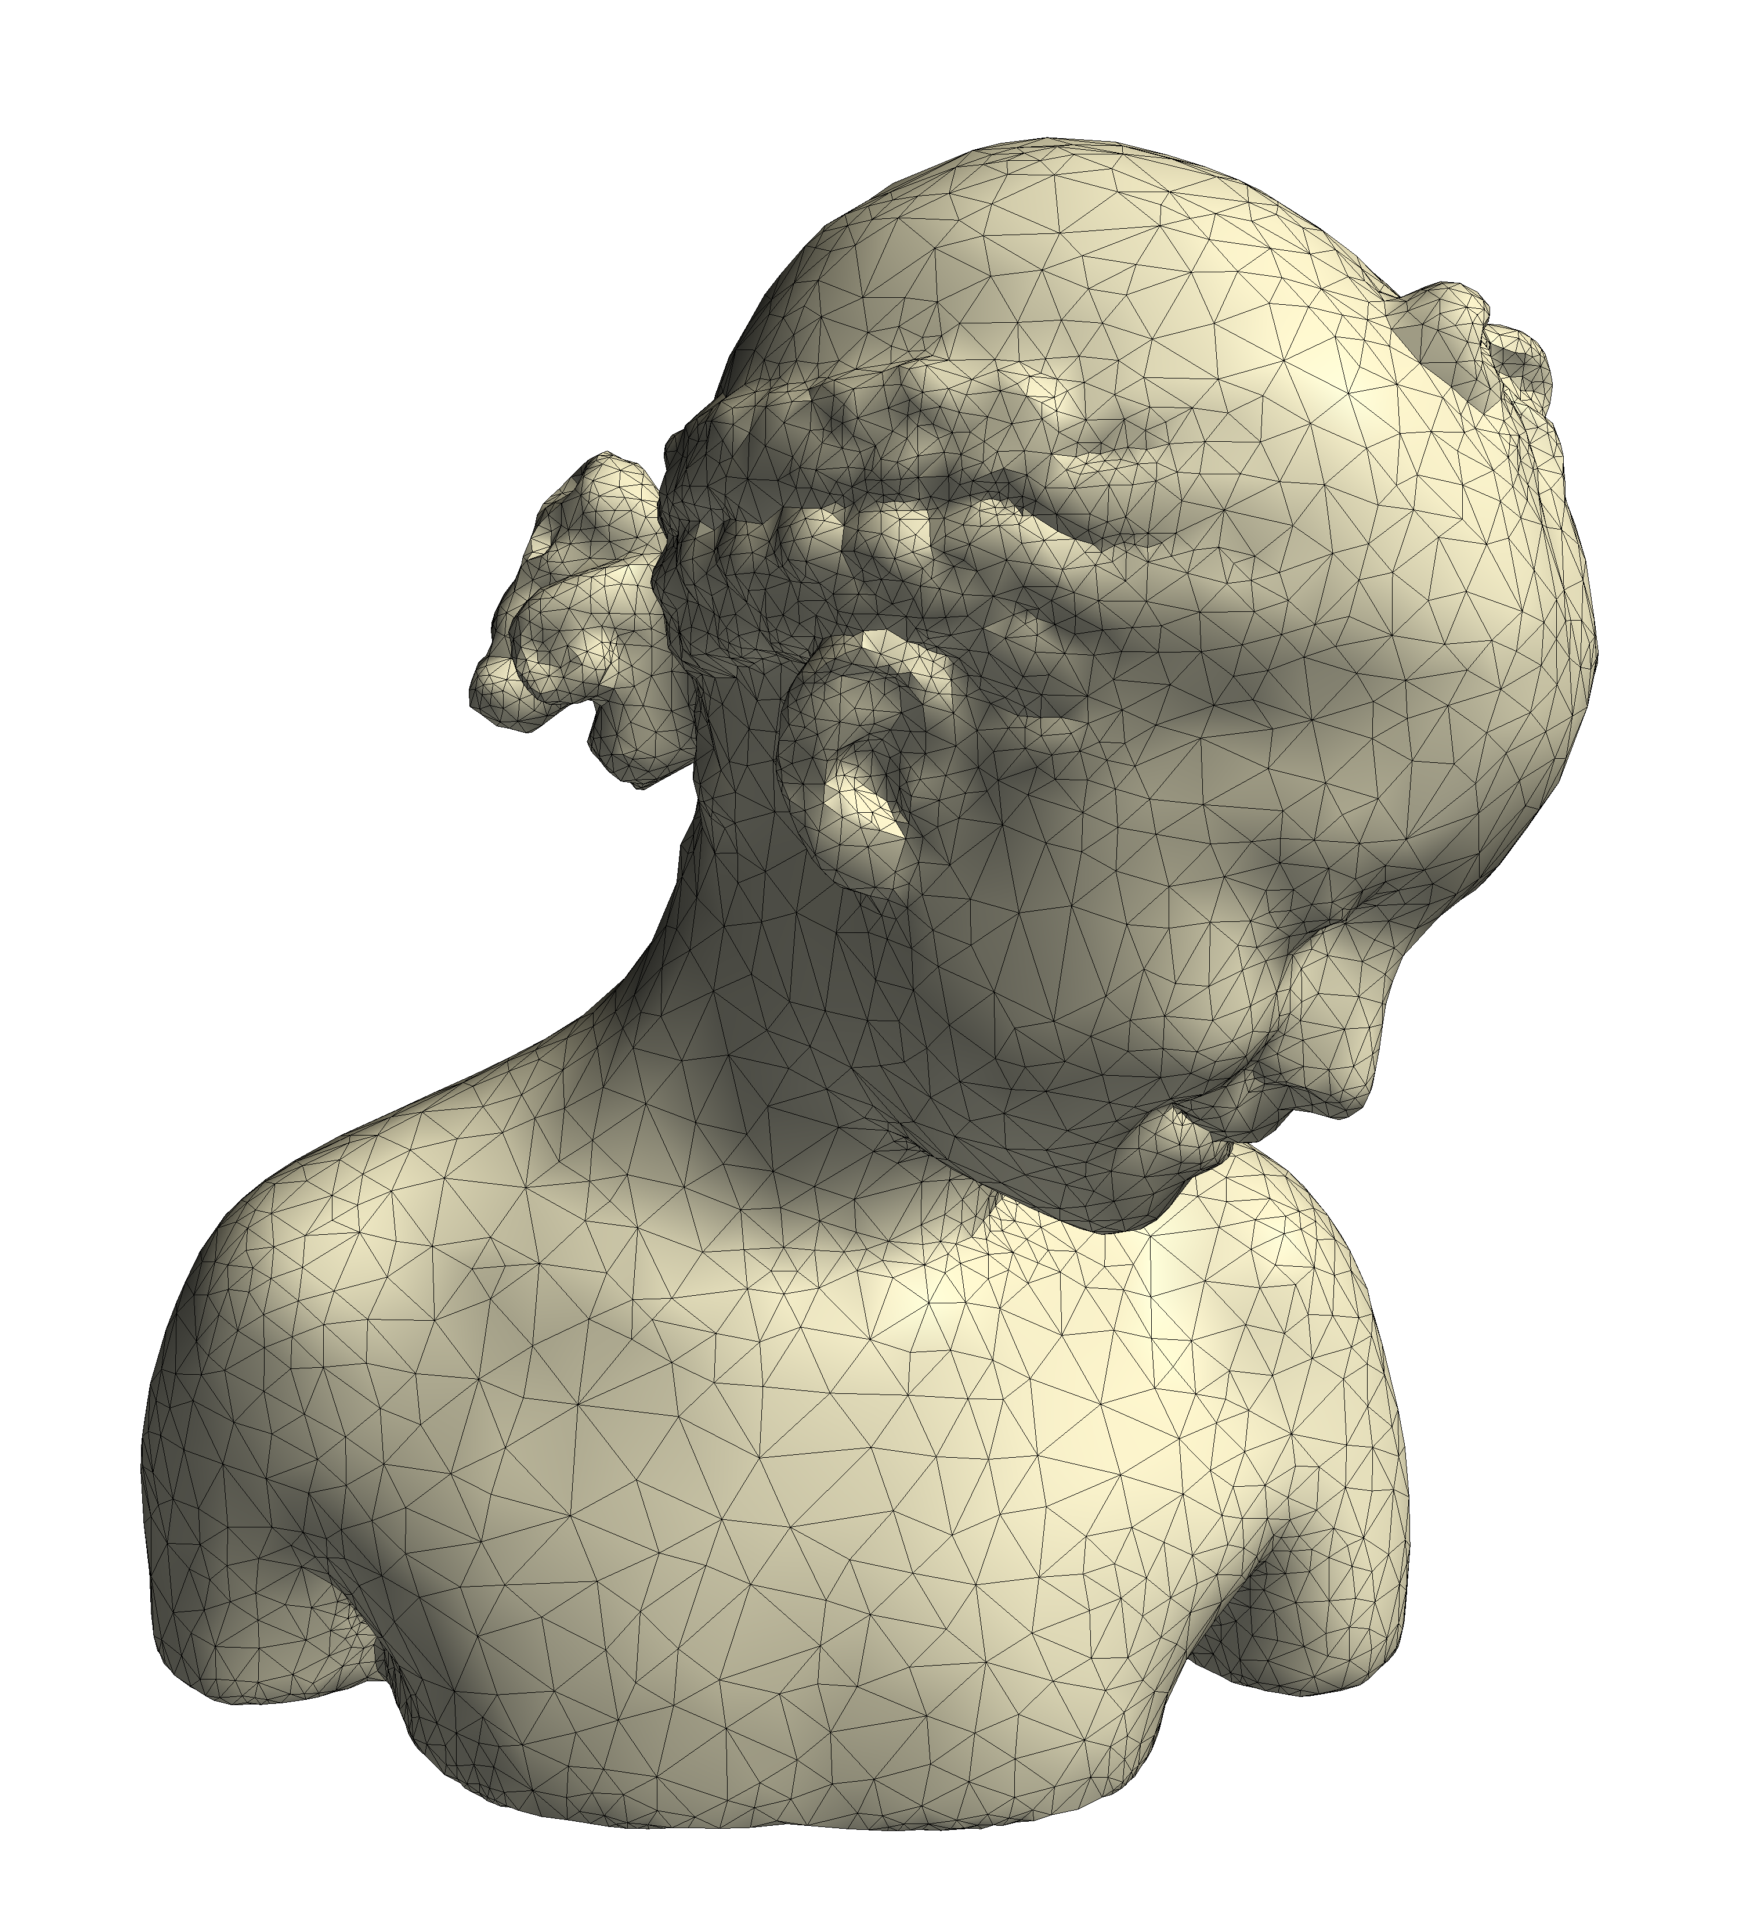
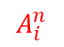
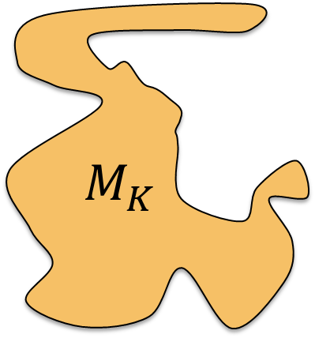
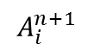
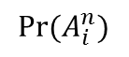
Naïve approach
Find closest continuous map (Solve Poisson)
$M_{K}$
K=30
K=8
$$A_{i}^{n}$$
$${Pr⁡(A}_{i}^{n})$$
$$A_{i}^{n+1}$$

Slide 16
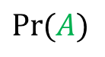

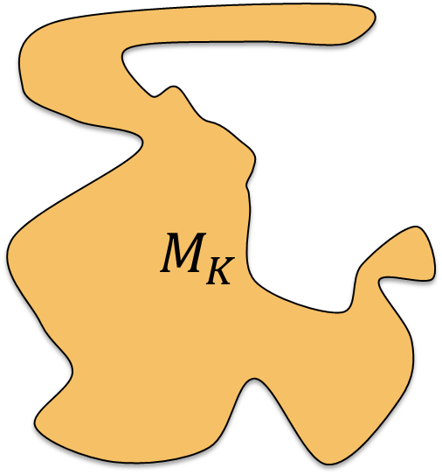

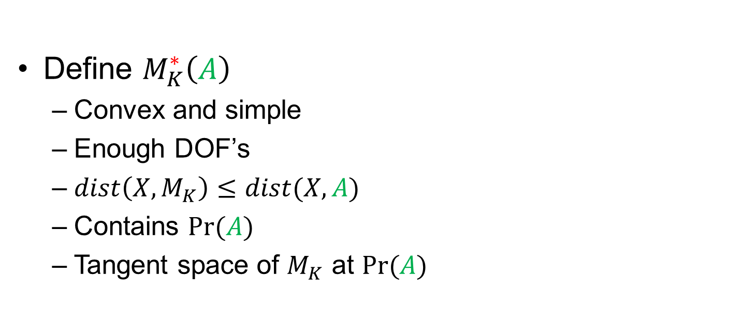
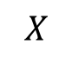
Approximation spaces to $M_{K}$
Define $M_{K}^{∗}\left(A\right)$
Convex and simple
Enough DOF’s
$dist\left(X,M_{K}\right)≤dist(X,A)$
Contains $Pr⁡(A)$
Tangent space of $M_{K}$ at $Pr⁡(A)$
$M_{K}$
$$X$$
$$A$$
$$Pr⁡(A)$$

Slide 17
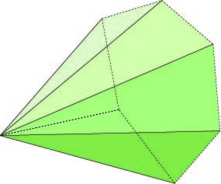
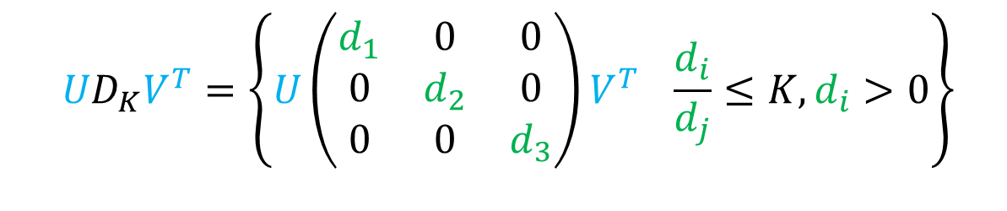
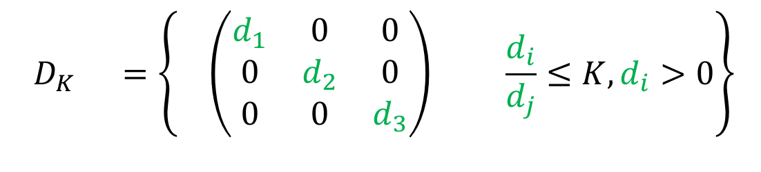


Construction of $M_{K}^{∗}(A)$
Set of diagonal BD matrices is simple
Can multiply by rotations
Contains $Pr⁡(A)$
$${UD}_{K}V^{T}=\left\{U\left(\begin{matrix}d_{1} & 0 & 0 \\ 0 & d_{2} & 0 \\ 0 & 0 & d_{3}\end{matrix}\right)V^{T} \frac{d_{i}}{d_{j}}≤K, d_{i}>0\right\}$$
$$D_{K} =\left\{ \left(\begin{matrix}d_{1} & 0 & 0 \\ 0 & d_{2} & 0 \\ 0 & 0 & d_{3}\end{matrix}\right) \frac{d_{i}}{d_{j}}≤K, d_{i}>0\right\}$$

Slide 18







Construction of $M_{K}^{∗}(A)$
$M_{K}$
$$U\left(\begin{matrix}d_{1}+O(ε) & O(ε) & O(ε) \\ O(ε) & d_{2}+O(ε) & O(ε) \\ O(ε) & O(ε) & d_{3}+O(ε)\end{matrix}\right)V^{T}$$
$$X=U\left(\begin{matrix}d_{1} & 0 & 0 \\ 0 & d_{2} & 0 \\ 0 & 0 & d_{3}\end{matrix}\right)V^{T}$$
$$U\left(\begin{matrix}d_{1} & O(ε) & O(ε) \\ O(ε) & d_{2} & O(ε) \\ O(ε) & O(ε) & d_{3}\end{matrix}\right)V^{T}$$
$$X$$
$O(ε)$ perturbation?
$⇒$ Change in singular values is $O(ε)$
$O(ε)$ perturbation only on offdiag?
$⇒$ Change in singular values is $O(ε^{2})$
Offdiag is the tangent to $M_{K}$!

Slide 19

The final approximation space
$$M_{K}^{∗}(A)=\left\{ \left.U\left(\begin{matrix}d_{1} & ε_{12} & ε_{13} \\ ε_{21} & d_{2} & ε_{23} \\ ε_{31} & ε_{32} & d_{3}\end{matrix}\right)V^{T}\right| \frac{d_{i}}{d_{j}}≤K, d_{i}>0\right\}$$

Slide 20







Last bit of magic
What keeps offdiag small?
$$X=U\left(\begin{matrix}d_{1} & ε_{12} & ε_{13} \\ ε_{21} & d_{2} & ε_{23} \\ ε_{31} & ε_{32} & d_{3}\end{matrix}\right)V^{T}$$
$$M_{K}^{∗}(A)$$
$$X$$
$$A$$
$$Pr⁡(A)$$
$$A=U\left(\begin{matrix}σ_{1} & 0 & 0 \\ 0 & σ_{2} & 0 \\ 0 & 0 & σ_{3}\end{matrix}\right)V^{T}$$

Slide 21







The approximation space $ℱ_{K}^{∗}$
$${ M}_{K}^{∗}\left(A_{i}\right)$$
$$A_{i}p+δ_{i}$$
$$ℱ_{K}^{∗}(Φ)$$
$$Φ$$

Slide 22



The algorithm
Original goal:
$$Pr\left(Φ\right)=\underset{Ψ∈ℱ_{K}}{argmin}Dist\left(Φ,Ψ\right)⁡$$
Replace with approximation space
Iterate to convergence: $Φ^{n+1}=Pr\left(Φ^{n}\right)$
In practice: ~7 iterations
Quadratic obj.
Linear ineq.
$$\underset{{}_{}^{∗}}{}⁡$$
$$\underset{ (Φ)}{}$$
Code available online

Slide 23

See it in action:

Slide 24
Compared to our 1st attempt

Slide 25
Results

Slide 26

Deformations

Slide 27





Global bijectivity in 3D
Theorem: If boundary mapped bijectively, map is a global bijection
$$Φ$$
$$Pr⁡(Φ)$$

Slide 28




Bijective BD parameterizations
$$Φ$$

Slide 29


Tet-mesh improvement
Optimal
Delaunay
Triangulation
Variational tet
Meshing [Alliez 2005]
Stellar
[Klinger 2007]

Slide 30

Tet-mesh improvement

Slide 31
Conclusions and future work
First algorithm for bounded-distortion, bijective maps in 3D
Shortcomings
Timing
Main question: feasibility
Future work
Applications in higher dimensions
Surface mappings

Slide 32
Acknowledgements
Code + data online
http://www.wisdom.weizmann.ac.il/~/noamaig/html/projects/bd3d/bd3d.html
Funding:
ERC Starting Grant “SurfComp”
Israel Science Foundation

Slide 33
Thank you!

